Slide 1
Induction Event

Slide 2
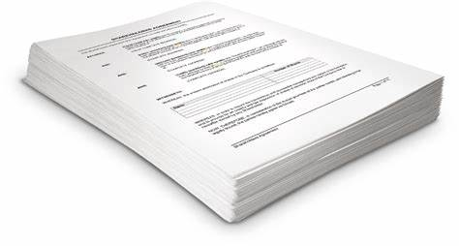
Domestics
Notes:
Advise:
Ask questions at any stage
No such thing as a silly question
Break times are not set…at appropriate point
Pre-course materials
Delegate Packs
Fire Alarm
Mobile Phones
Comfort Breaks
Refreshments
Timings

Slide 3
Aim
To introduce you to the role of Ready for Anything volunteer
Notes:
Command, Control and Co-ordination are from JESIP

Slide 4
Objectives
By the end of this session, you will be able to;
Correctly understand the Ready for Anything role and how this fits into the wider resilience structure
Correctly identify your role responsibilities

Slide 5
Agenda
Welcome and Introductions
The Lincolnshire Resilience Forum
JESIP Principles
Your Role, Responsibilities
Code of Conduct
JESIP – JDM & METHANE
The Future
Administration

Slide 6
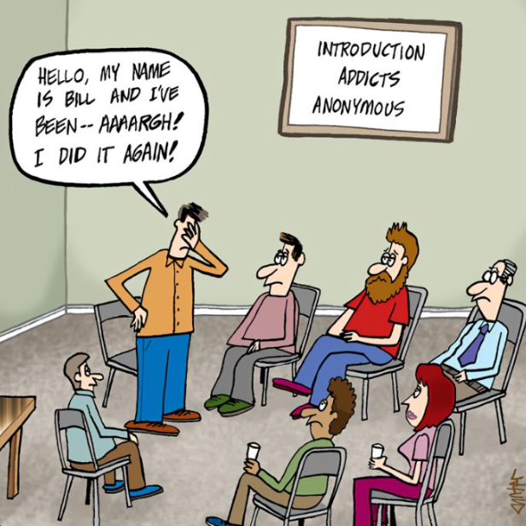
Introductions
Your name
Reason for volunteering
Interesting fact about yourself
Notes:
Ask attendees to introduce themselves giving:
Their name
Reason for volunteering
Interesting/fun fact about themselves – optional for attendees
Trainer/Presenter to start this off with their own details

Slide 7
Lincolnshire Resilience Forum
FloodX Draft 1_15 on Vimeo
Notes:
Advise: The following video was taken during the FloodEx22 exercise that took place in November 2022.
Play the video.
Animation: The CCA 2004 came into force following fuel shortages, flooding and foot & mouth disease outbreak in the early 2000s. This placed responsibilities on responders to ensure that they planned for and worked together for future emergencies.
Discuss: Local resilience forums are in place to plan and prepare for local incidents and major emergencies. We identify the risks to Lincolnshire and produce emergency plans to mitigate those risks and protect our local communities.
Advise: a link to the CCA short guide will be sent out following the training for those interested in further reading.

Slide 8
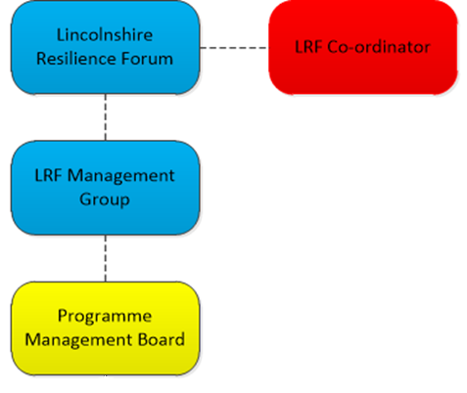
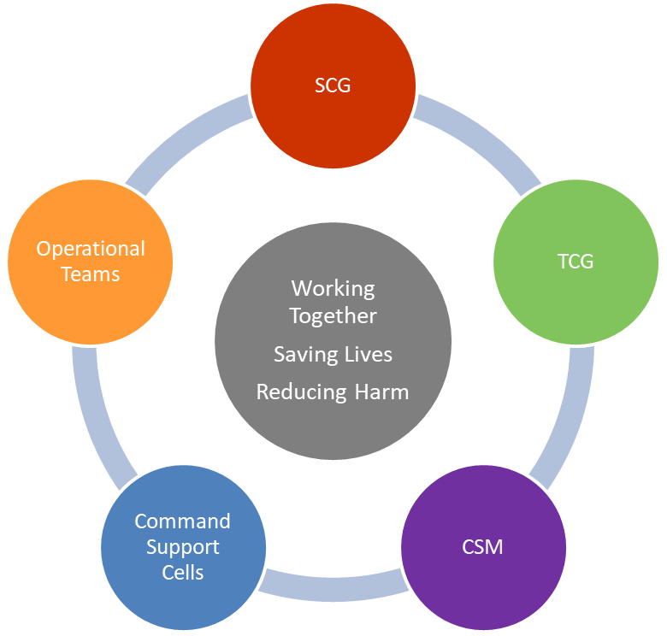
LRF Structure
Notes:
Discuss: 38 LRFs in England and 4 in Wales. LRFs are set by police force areas.
The forum is made up of category one and two responders as detailed in the Civil Contingencies Act 2004 (next slide).
The forum must meet twice yearly (in Lincolnshire, we meet 3 times) and this is senior Exec level staff from partners.
The LRF Management Group meet monthly and have devolved authority from the forum. This group is made up of the Forum Chair & Deputy, Head of EP&BC, PMB Chair and GLO.
Animation: During emergencies, we have a structure in place, using the Joint Decision Model (covered later).
Discuss: the different parts of the structure and where the RFA volunteers sit in this structure (operational teams).

Slide 9
Team Structure
Ian Reed
Head of EP & BC
Paula Danville
Senior EP & BC Officer
2 x Business Support Officers
4 x EP & BC
Officers
Sue Whitton
Senior EP & BC Officer
2 x EP & BC
Officers
LRF Project & Training Officer
LRF Project Assistant
Notes:
Discuss:
The team is employed by LCC.
LRF partners pay a fee towards the LRF which covers training, administration and other costs for the LRF as a whole.
Each EP&BC Officer provides EP&BC support to the district councils through an SLA.
The team provide the secretariat function for the LRF on a daily basis.
Not all LRFs are structured in the same way as Lincolnshire.
The team are your link into the LRF and you will be activated through the team.

Slide 10
JESIP Principles
Notes:
Note: Awareness Only with laminate aide memoire to support (more later)
Discuss: The findings and lessons from historic public enquiries highlight cases where emergency services could have worked better.
Lincolnshire LRF work to these principles, utilise CEC, etc..
Co-Locate – Meet as early as possible at a jointly agreed location (Forward Command Post) to establish jointly agreed objectives and a co-ordinated plan. Benefits of co-location apply to all levels of command.
Communicate – Meaningful/effective communication underpins effective joint working. Sharing/understanding information aids the development of shared situational awareness.
Co-ordination – Commanders discussing resources and activities of each responder agency, agreeing priorities and making joint decisions. This avoids potential conflicts, prevents duplication of effort and minimises risk. One agency tends to take the lead role.
Joint Understanding of Risk – Different responder agencies may see, understand and treat risks differently. Each agency should carry out their own dynamic risk assessment and share the results so control measures and contingencies can be planned together more effectively.
Shared Situational Awareness – Common understanding of the circumstances , immediate consequences and implications of the emergency, along with the available capabilities and the priorities of the emergency services and responder agencies.

Slide 11
Previous Incidents
2022​
8th – 19th September ​ | Operation London Bridge​ | 4 x SCG and 5 x TCG – 3 x cells (MAIC / W&I / R&L)​
11th July​ | Heat Health Alert L4​ | Pre-cautionary SCGx3, Health Response, Warn and Inform Cell​
17th February​ | Storm Eunice​ | HAT, Pre-cautionary SCG x 2, response cell at Police HQ (Police, LCC Highways, LCC EP & Fire) to co-ordinate incidents.​
2020​
Jan – March 22​ | Covid-19​ | LRF SCG, RCG & TCG held. Incident went into and out of response as COVID cases rose.​
2019​
12th – 24th June​ | Operation Biography​ | LRF SCG & TCG held. CEC activated. Breach in Relief Channel on River Steeping flooding Wainfleet.​
2018​
9th October​ | Suspect package at bus station​ | LRF SCG held. EOD in attendance. 3 potential sites. CT incident? Lincoln City Centre evacuated, train, bus and road services stopped – main arterial routes.​
Feb / Mar​ | Snow response​ | LRF pre-cautionary SCG held on 26th Feb - CEC activated & command and control arrangements made. CEC operational until 1st March.​
Notes:
Discuss:
These are a selection of incidents that have happened over the last few years.
This list is not exhaustive.
RFA Volunteers would not have been involved in all of these incidents, but would have been required for some (see next slide for activity).

Slide 12
Your Role Activity
Notes:
Activity:
In smaller groups, learners to create a list of possible activities they may get involved in as a RFA volunteer.
Groups should write their ideas on flip chart paper.
Allow 5 minutes before asking each group to present their findings to the main group.
Once all groups have presented, use the next slide to debrief the activity.

Slide 13
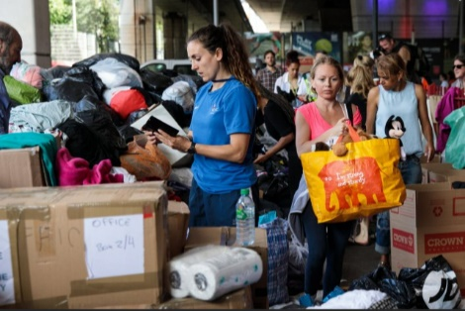
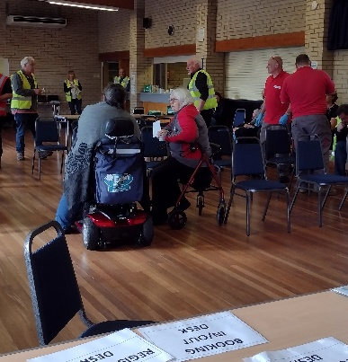
Your Role - Debrief
Notes:
Debrief:
Working in Places of Safety
Meet and Greet
Making Tea/Coffee
Providing a sympathetic ear
Door knocking
Supporting families post emergency such as helping to get room back to some semblance of normal
Advise: This list is not exhaustive and any necessary tasks will be discussed ahead of deployment.
Discuss: Other activities may include;
Distribution of donated items: sorting out clothing / bagging up food parcels
Assisting with evacuated pets
Provision of light refreshments
Assistance in interpreting/translation (not medical interpretation)
Cleaning
Assisting with re-occupation of homes/affected sites
Physical labour (such as street/ house clean up)
Community Impact Assessments – an assessment of the overall impact of the incident on the community
Open area searching (Only under supervision of Police Search Advisors)
Clearing Snow and Ice

Slide 14
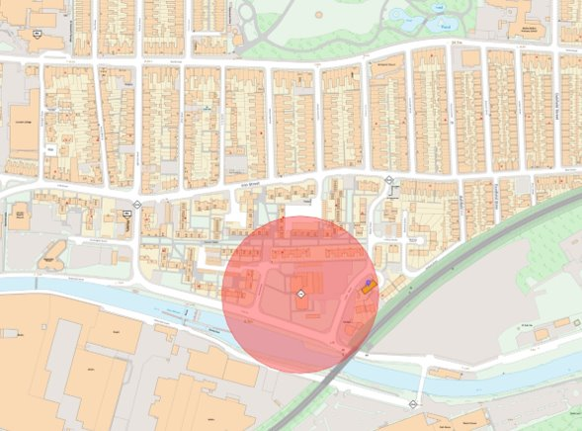
Activation & Deployment
Notes:
Discuss:
Activation via the EP&BC team, initially via text message
Once text accepted, a phone call will made to you, with a follow up email with all the information you need (where to meet, coordinator details, welfare, etc.)
Deployment will be within an agreed radius of your home (this may be across county borders with agreement)

Slide 15
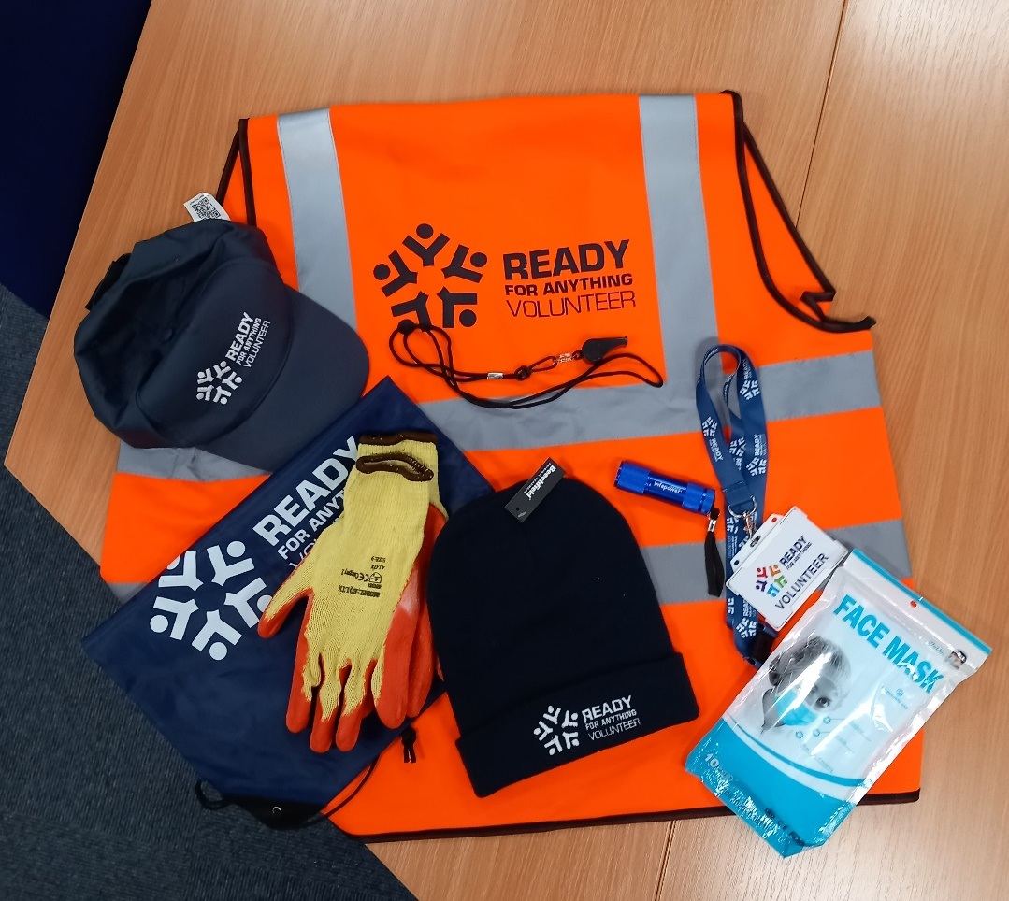
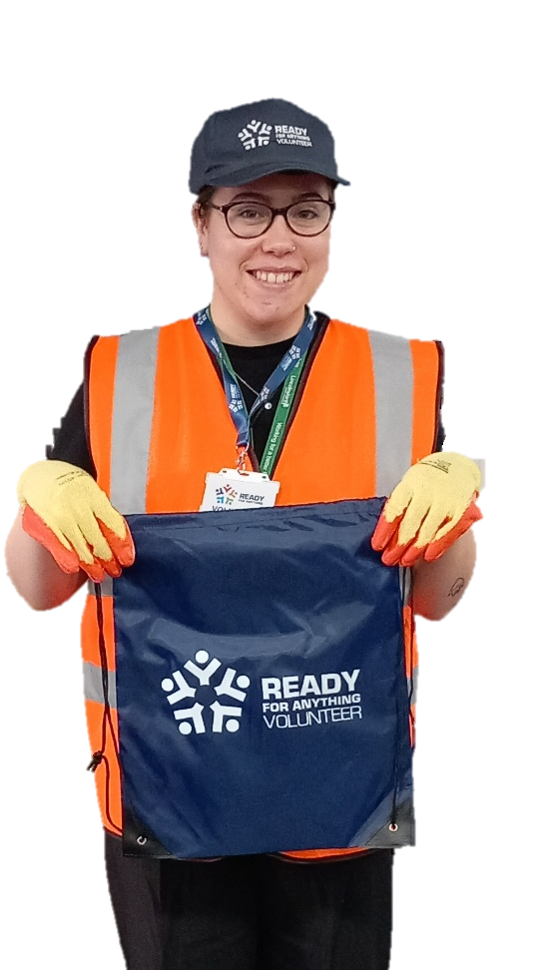
Your Kit
Notes:
Discuss: You will be provided with:
RFA baseball cap
RFA beanie hat
Hi-Vis vest
Generic ID badge – not to be used outside of RFA volunteering role
Torch
Emergency Whistle
Work gloves
Face coverings
Ask: What other things might you want to consider having/bringing along?
Look for:
Warm clothing
Comfortable/suitable footwear
Fully charged phone
Initial refreshments for yourself
Medication you may need

Slide 16
Code of Conduct
Notes:
Activity: In smaller groups, learners to come up with a list of behaviours, rules, etc. that are required of RFA volunteers.
After 5 minutes, groups to present back.
Ensure: the following are covered/discussed;
Keep your contact details up-to-date
Provide next of kin details
Attend training to maintain your competence
Notify us of any special skills, training, experience, etc.
Maintain your wellbeing & notify us if you need support, etc.
Act professionally
Complete assigned tasks
Maintain confidentiality, adhering to GDPR
No photos, social media posts, etc.
Record notes in log, etc. as directed
Maintain equipment provided and report any damage/loss
Escalate any issues, conflicts, safeguarding, etc.
Discuss your role with family members – they may be concerned

Slide 17
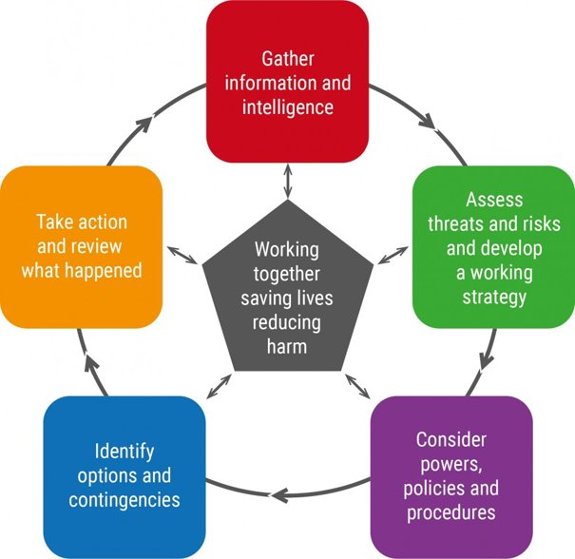
JESIP – Joint Decision Model
Notes:
Handout: JESIP Aide Memoire
Note: This is for awareness only
Discuss: One of the difficulties facing commanders from different responder agencies is how to bring together the available information, reconcile potentially differing priorities and then make effective decisions together.
By adopting the JESIP principles discussed earlier and using the Joint Decision Model methodology, commanders can make effective and defensible decisions during emergency response. The use of this model helps when being scrutinised.
Responder agencies may use various supporting processes and sources to provide commanders with information, including information on any planned intentions, to commanders.
All joint decisions, and the rationale behind them, should be recorded in a ‘joint decision log’.
First Priority – Gather and assess information/intelligence, build a shared situational awareness, recognising that this requires continuous effort as the situation, and the responder’s understanding, will change over time.

Slide 18
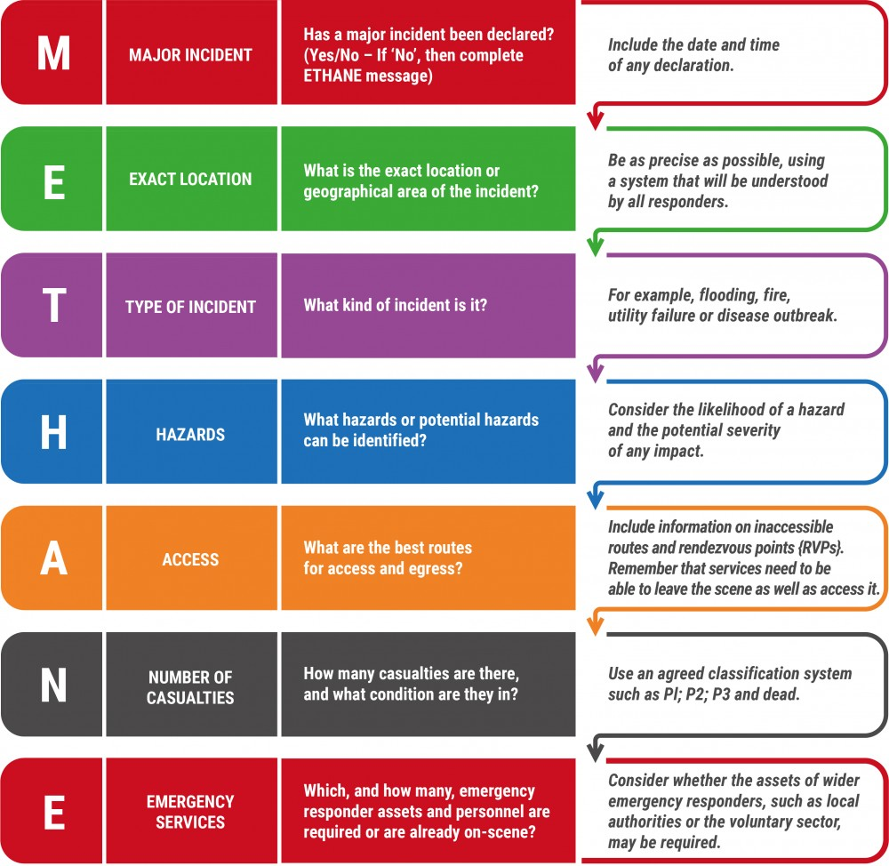
JESIP - METHANE
METHANE
Notes:
Discuss: Responders use a mnemonic to pass information to control rooms and each other to ensure clear information is available.
Play: video and refer learners to their laminated aide memoire
Slide Animation
Debrief and Discuss: we ask members of community groups, volunteers, etc,. To use this mnemonic when passing information, where applicable.
Advise: If answers to “M” is no (not a major incident) staff should continue with ETHANE message and regularly review situation in case of escalation to major incident. JESIP App and Aide Memoire provide reminder of M/ETHANE)

Slide 19
The Future
Rolling Schedule of Training
Quarterly Meetings
Exercises
Email Contact
Self-Directed Learning
Notes:
Discuss:
Rolling schedule of training with providers such as Lives, Red Cross, etc.
Quarterly meetings will be held to provide updates, share learning, discuss future exercises, etc.
Invites to community, local and major exercises to observe/take part as required
Email address created for contact outside of the above sessions
News, articles, information and website links will be sent out to enable you to read/review at your leisure (make sure you share any news with us that you feel is useful)
Discuss: If there is any particular training you would like to see, let us know. Attendance isn’t mandatory but may impact how we can utilise your support during incidents.
Note: Induction days will be run periodically during the year, outside of the rolling training schedule.

Slide 20
Administration
Notes:
Share: the volunteer handbook with the group
Discuss:
When activated, you will indemnified through LCCs insurance. It is important that you don’t self-deploy to ensure that you are covered by this.
During exercises, events, etc. we regularly take photos for use on social media, publicity materials, our website, etc. and these are used for up to 5 years. The indemnity form is your agreement for us to do this.

Slide 21
Questions
RFA Email Address
Notes:
Answer any questions that are raised and advise attendees to use the email address to submit any questions they think about after the event.

Slide 22
Objectives
You are now able to;
Correctly understand the Ready for Anything role and how this fits into the wider resilience structure
Correctly identify your role responsibilities

